Slide 1
Chapter One
Introduction to Computer Networks and Data Communications
Data Communications and Computer Networks: A Business User's Approach
Eighth Edition

Slide 2
After reading this chapter, you should be able to:
Define the basic terms of computer networks
Recognize the individual components of the big picture of computer networks
Outline the common examples of communications networks
Define the term “convergence” and describe how it applies to computer networks
Cite the reasons for using a network architecture and explain how they apply to current network systems
Data Communications and Computer Networks: A Business User's Approach, Eighth Edition

Slide 3
After reading this chapter, you should be able to (continued):
List the layers of the TCP/IP protocol suite and describe the duties of each layer
List the layers of the OSI model and describe the duties of each layer
Compare the TCP/IP protocol suite and the OSI model and list their differences and similarities
Data Communications and Computer Networks: A Business User's Approach, Eighth Edition

Slide 4
Introduction
Who today has not used a computer network?
Mass transit, interstate highways, 24-hour bankers, grocery stores, cable television, cell phones, businesses and schools, and retail outlets support some form of computer network
Data Communications and Computer Networks: A Business User's Approach, Eighth Edition

Slide 5
The Language of Computer Networks
Computer network – an interconnection of computers and computing equipment using either wires or radio waves over small or large geographic areas
Local area network – networks that are small in geographic size spanning a room, floor, building, or campus
Metropolitan area network – networks that serve an area of 1 to 30 miles, approximately the size of a typical city
Data Communications and Computer Networks: A Business User's Approach, Eighth Edition

Slide 6
The Language of Computer Networks (continued)
Wide area network – a large network that encompasses parts of states, multiple states, countries, and the world
Personal area network – a network of a few meters, between wireless devices such as PDAs, laptops, and similar devices
Campus area network – a network that spans multiple buildings on a business or school campus
Data Communications and Computer Networks: A Business User's Approach, Eighth Edition

Slide 7
The Language of Computer Networks (continued)
Voice network – a network that transmits only telephone signals (essentially xtinct)
Data network – a network that transmits voice and computer data (replacing voice networks)
Data Communications and Computer Networks: A Business User's Approach, Eighth Edition

Slide 8
The Language of Computer Networks (continued)
Data communications – the transfer of digital or analog data using digital or analog signals
Telecommunications – the study of telephones and the systems that transmit telephone signals (becoming simply data communications)
Network management – the design, installation, and support of a network, including its hardware and software
Network cloud – a network (local or remote) that contains software, applications, and/or data
Data Communications and Computer Networks: A Business User's Approach, Eighth Edition

Slide 9
The Big Picture of Networks
Networks are composed of many devices, including:
  Workstations (computers, tablets, wireless phones, etc)
  Servers
  Network switches
  Routers (LAN to WAN and WAN to WAN)
  Network nodes and subnetworks
Data Communications and Computer Networks: A Business User's Approach, Eighth Edition

Slide 10
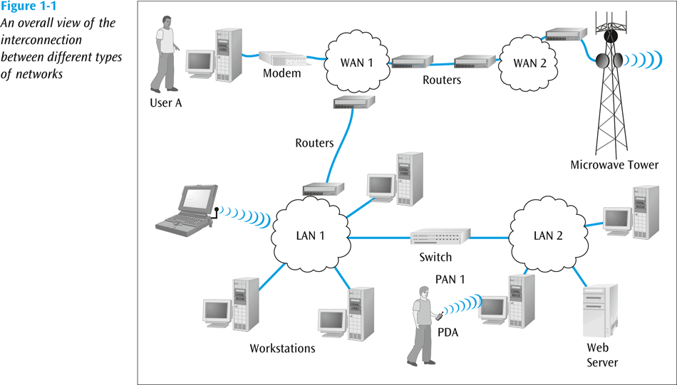
The Big Picture of Networks (continued)
Data Communications and Computer Networks: A Business User's Approach, Eighth Edition

Slide 11
Common Examples of Communications Networks
The desktop computer and the Internet
A laptop computer and a wireless connection
Cell phone networks
Industrial sensor-based systems
Mainframe systems
Satellite and microwave networks
Data Communications and Computer Networks: A Business User's Approach, Eighth Edition

Slide 12
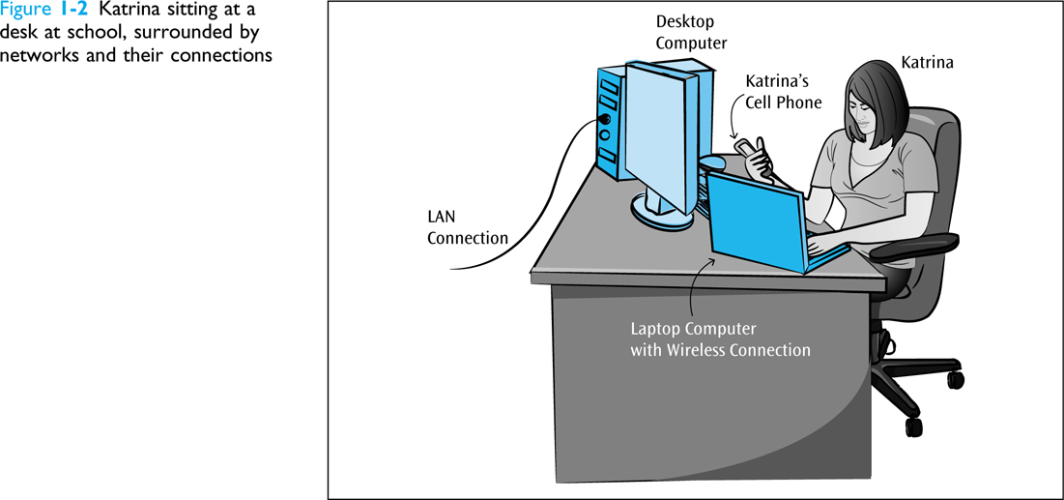
Common Examples of Communications Networks
Data Communications and Computer Networks: A Business User's Approach, Eighth Edition

Slide 13
The Desktop Computer and the Internet
Common throughout business, academic environments, and homes
Typically a medium- to high-speed connection
Computer (device) requires a NIC (network interface card)
NIC connects to a hub-like device (switch)
Often considered a client/server system
Data Communications and Computer Networks: A Business User's Approach, Eighth Edition

Slide 14
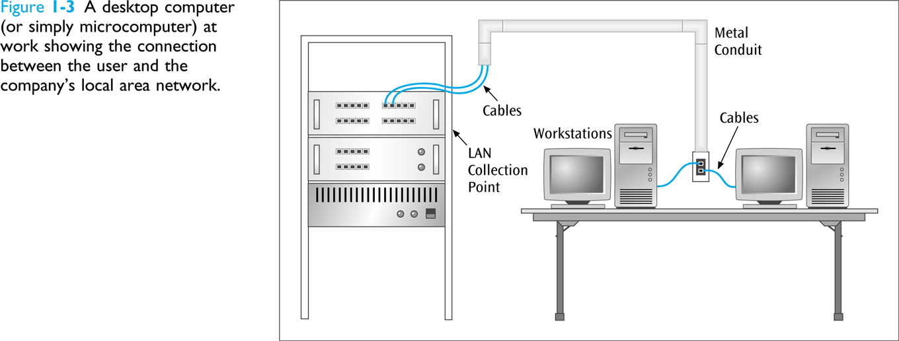
The Desktop Computer and the Internet
Data Communications and Computer Networks: A Business User's Approach, Eighth Edition

Slide 15
The Desktop Computer and the Internet
At work or at school – connection is typically some form of Ethernet
At home, for some, a dial-up modem is used to connect user’s microcomputer to an Internet service provider
Technologies such as DSL and cable modems are replacing dial-up modems
Data Communications and Computer Networks: A Business User's Approach, Eighth Edition

Slide 16
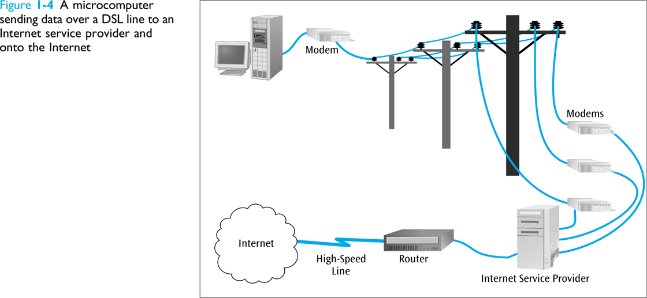
The Desktop Computer and the Internet
Data Communications and Computer Networks: A Business User's Approach, Eighth Edition

Slide 17
A Laptop Computer and a Wireless Connection
At work or at school – connection is typically some form of wireless Ethernet
Laptop wirelessly communicates with a wireless router or wireless access point
Wireless router is typically connected to a wired-network
Data Communications and Computer Networks: A Business User's Approach, Eighth Edition

Slide 18
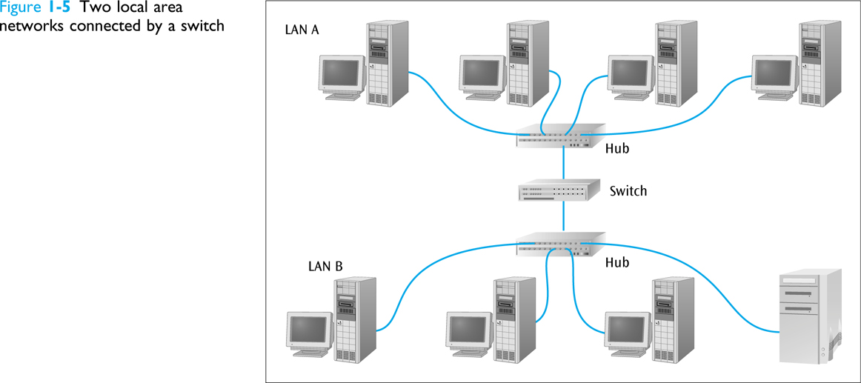
A Laptop Computer and a Wireless Connection
Data Communications and Computer Networks: A Business User's Approach, Eighth Edition

Slide 19
Cell Phone Networks
Constantly expanding market across the U.S. and world
Third generation services available in many areas and under many types of plans with fourth generation services starting to appear
Latest generation includes higher speed data transfers (100s to 1000s of kilobits per second)
Data Communications and Computer Networks: A Business User's Approach, Eighth Edition

Slide 20
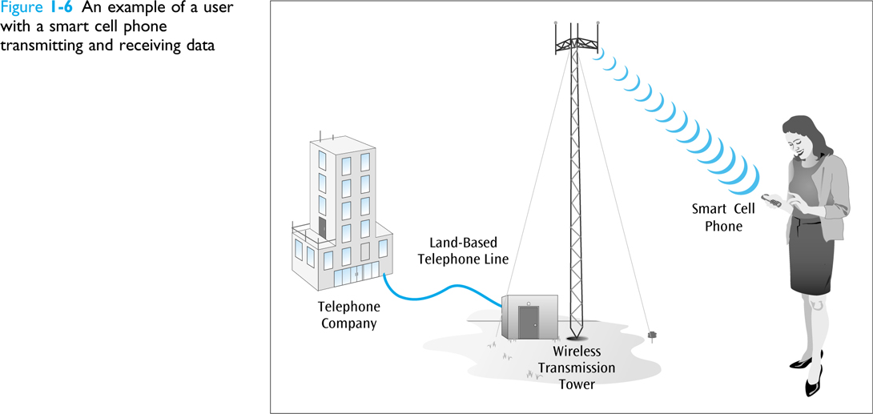
Cell Phone Networks (continued)
Data Communications and Computer Networks: A Business User's Approach, Eighth Edition

Slide 21
Industrial Sensor-based Systems
Not all local area networks deal with microcomputer workstations
Often found in industrial and laboratory environments
Assembly lines and robotic controls depend heavily on sensor-based local area networks
Data Communications and Computer Networks: A Business User's Approach, Eighth Edition

Slide 22
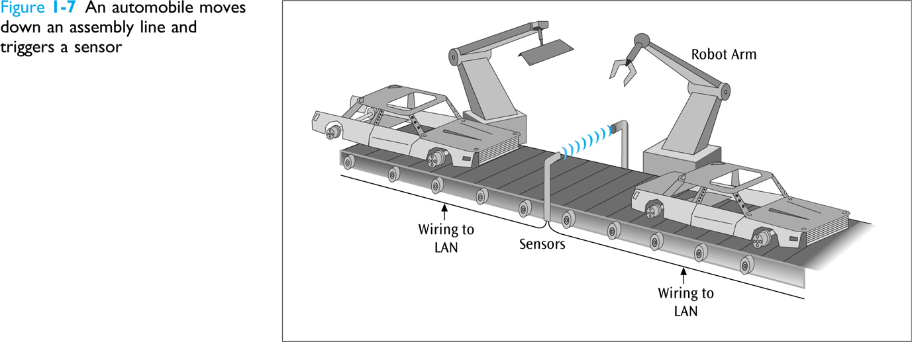
Industrial Sensor-based Systems
(continued)
Data Communications and Computer Networks: A Business User's Approach, Eighth Edition

Slide 23
Mainframe Systems
Predominant form in the 1960s and 1970s
Still used in many types of businesses for data entry and data retrieval
Few dumb terminals left today – most are microcomputers with terminal emulation card, a web browser and web interface, Telnet software, or a thin client
Data Communications and Computer Networks: A Business User's Approach, Eighth Edition

Slide 24
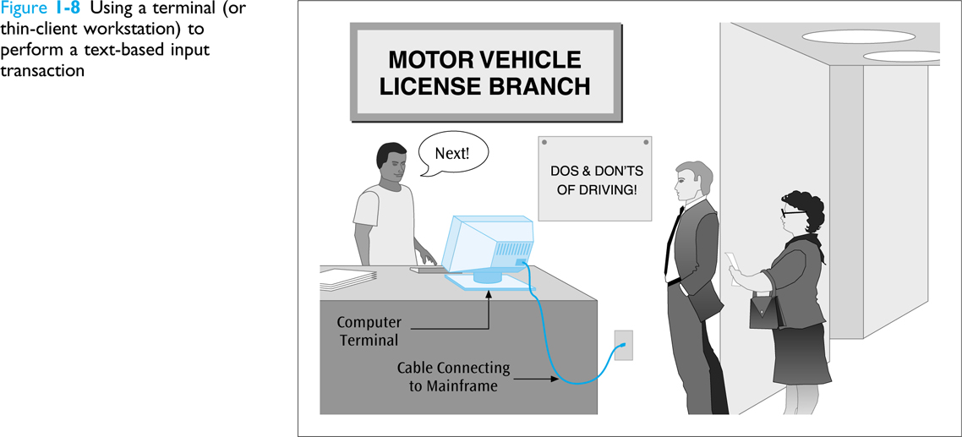
Mainframe Systems (continued)
Data Communications and Computer Networks: A Business User's Approach, Eighth Edition

Slide 25
Satellite and Microwave Networks
Typically long distance wireless connections
Many types of applications including long distance telephone, television, radio, long-haul data transfers, and wireless data services
Typically expensive services but many companies offer competitive services and rates
Newer shorter-distance services such as Wi-Max
Data Communications and Computer Networks: A Business User's Approach, Eighth Edition

Slide 26
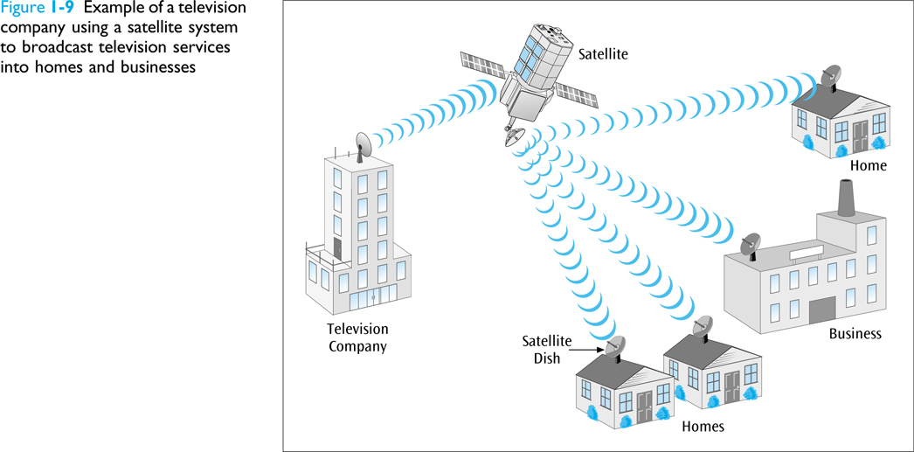
Satellite and Microwave Networks (continued)
Data Communications and Computer Networks: A Business User's Approach, Eighth Edition

Slide 27
Network Architectures
A reference model that describes the layers of hardware and software necessary to transmit data between two points or for multiple devices / applications to interoperate
Reference models are necessary to increase likelihood that different components from different manufacturers will converse
Two models to learn: TCP/IP protocol suite and OSI model
Data Communications and Computer Networks: A Business User's Approach, Eighth Edition

Slide 28
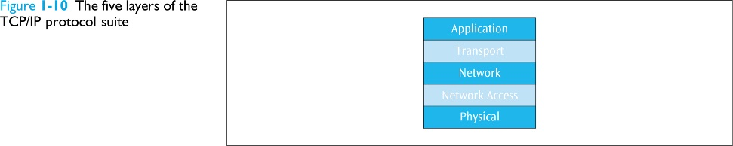
The TCP/IP Protocol Suite
Note: Some authors show only four layers, combining the two
bottom layers.
Data Communications and Computer Networks: A Business User's Approach, Eighth Edition

Slide 29
The TCP/IP Protocol Suite (continued)
Application layer
  Where the application using the network resides
  Common network applications include web browsing, e-mail, file transfers, and remote logins
Transport layer
  Performs a series of miscellaneous functions (at the end-points of the connection) necessary for presenting the data package properly to the sender or receiver
Data Communications and Computer Networks: A Business User's Approach, Eighth Edition

Slide 30
The TCP/IP Protocol Suite (continued)
Network (Internet or internetwork or IP) layer
  Responsible for creating, maintaining and ending network connections
  Transfers data packet from node to node (e.g. router to router) within network
Network access (data link) layer
  Responsible for taking the data and transforming it into a frame with header, control and address information, and error detection code, then transmitting it between the workstation and the network
Physical layer
  Handles the transmission of bits over a communications channel
  Includes voltage levels, connectors, media choice, modulation techniques
Data Communications and Computer Networks: A Business User's Approach, Eighth Edition

Slide 31
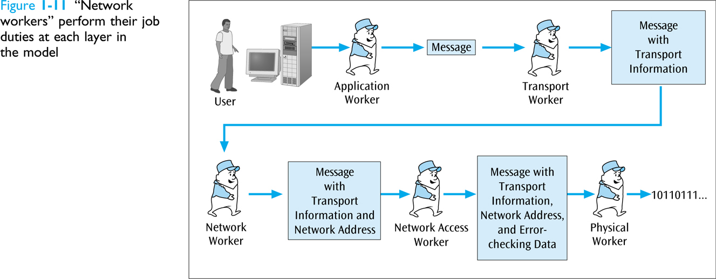
The TCP/IP Protocol Suite (continued)
Data Communications and Computer Networks: A Business User's Approach, Eighth Edition

Slide 32
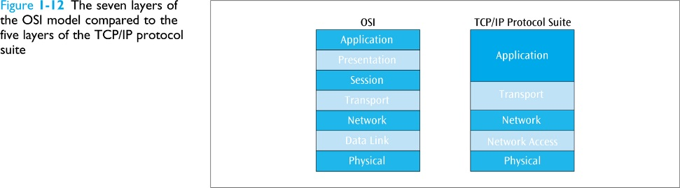
The Open Systems Interconnection (OSI) Model
Data Communications and Computer Networks: A Business User's Approach, Eighth Edition

Slide 33
The Open Systems Interconnection (OSI) Model (continued)
Application layer
  Equivalent to TCP/IP’s application layer
Presentation layer
  Responsible for “final presentation” of data (code conversions, compression, encryption)
Session layer
  Responsible for establishing “sessions” between users
Data Communications and Computer Networks: A Business User's Approach, Eighth Edition

Slide 34
The Open Systems Interconnection (OSI) Model (continued)
Transport layer
  Equivalent to TCP/IP’s transport layer
Network layer
  Equivalent to TCP/IP’s network layer
Data link layer
  Responsible for taking the data and transforming it into a frame with header, control and address information, and error detection code
Data Communications and Computer Networks: A Business User's Approach, Eighth Edition

Slide 35
The Open Systems Interconnection (OSI) Model (continued)
Physical layer
  Handles the transmission of bits over a communications channel
  Includes voltage levels, connectors, media choice, modulation techniques
Data Communications and Computer Networks: A Business User's Approach, Eighth Edition

Slide 36
Logical and Physical Connections
A logical connection is one that exists only in the software, while a physical connection is one that exists in the hardware
Note that in a network architecture, only the lowest layer contains the physical connection, while all higher layers contain logical connections
Data Communications and Computer Networks: A Business User's Approach, Eighth Edition

Slide 37
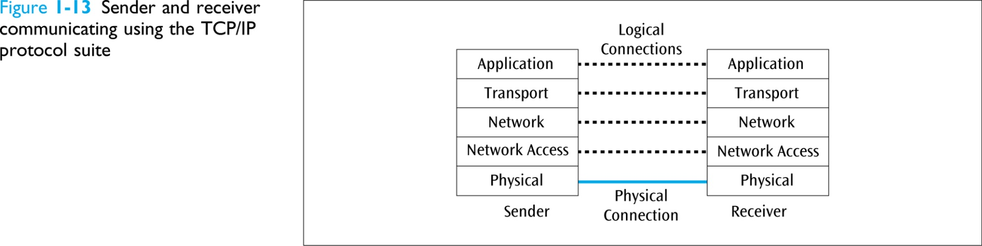
Logical and Physical Connections (continued)
Data Communications and Computer Networks: A Business User's Approach, Eighth Edition

Slide 38
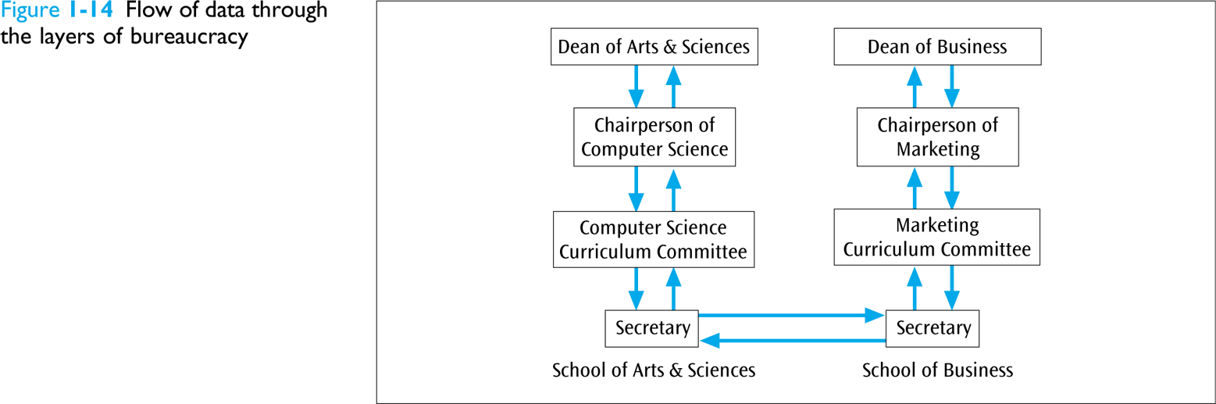
Logical and Physical Connections (continued)
Data Communications and Computer Networks: A Business User's Approach, Eighth Edition

Slide 39
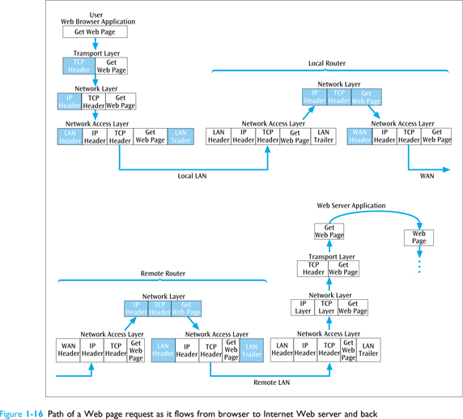
The TCP/IP Protocol Suite in Action
Data Communications and Computer Networks: A Business User's Approach, Eighth Edition

Slide 40
Summary
Many services and products that we use every day employ computer networks and data communications in some way
Field of data communications and computer networks includes data networks, voice networks, wireless networks, local area networks, metropolitan area networks, wide area networks, and personal area networks
Data Communications and Computer Networks: A Business User's Approach, Eighth Edition

Slide 41
Summary (continued)
Common examples of communications networks:
  The desktop computer and the Internet
  A laptop computer and a wireless connection
  Cell phone networks
  Industrial sensor-based systems
  Mainframe systems
  Satellite and microwave networks
Data Communications and Computer Networks: A Business User's Approach, Eighth Edition

Slide 42
Summary (continued)
Key concept in networking is convergence
A network architecture, or communications model, places network pieces in layers
  Layers define model for functions or services that need to be performed
The TCP/IP protocol suite is also known as the Internet model and is composed of five layers (some show four):
  Application layer
  Transport layer
  Network layer
  Network access layer
  Physical layer
Data Communications and Computer Networks: A Business User's Approach, Eighth Edition

Slide 43
Summary (continued)
The International Organization for Standardization (ISO) created the Open Systems Interconnection (OSI) model
  OSI model is based on seven layers: application layer, presentation layer, session layer, transport layer, network layer, data link layer, physical layer
A logical connection is a flow of ideas that occurs, without a direct physical connection, between the sender and receiver at a particular layer
Data Communications and Computer Networks: A Business User's Approach, Eighth Edition

